Slide 1


Building Blocks of Angular 2 and ASP.NET Core
By Levi Fuller

Slide 2

Overview
Angular CLI
Overview & Commands
Angular 2
Overview
Template Binding
Decorators
Lifecycle Hooks
Directives
Components
Pipes
Injectables (Services)
Modules
ASP.NET Core
Overview
Commands / Files
Dependency Injection
Controllers
Pet Store Demo

Slide 3
Angular CLI

Slide 4
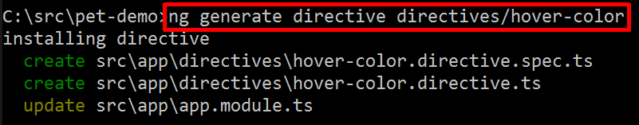
What is the Angular CLI?
Scaffold | Usage
Component | ng g component my-new-component
Directive | ng g directive my-new-directive
Pipe | ng g pipe my-new-pipe
Service | ng g service my-new-service
Class | ng g class my-new-class
Interface | ng g interface my-new-interface
Enum | ng g enum my-new-enum
Module | ng g module my-module
Provides a set of commands which enable you to:
Scaffold a new app
Scaffold the building blocks
Run the application
Build the application
Deploy it

Slide 5
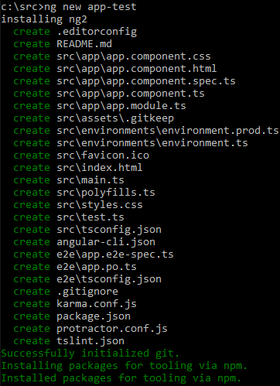
NG2 with the Angular CLI
ng new <app-name>
Creates new directory and creates the app scaffolding inside the new directory
ng serve
Runs the application in memory via LiveReload server
ng build
Bundles the application via webpack and copies the output to the `dist` directory
ng github-pages:deploy
Builds the app, setups a GitHub repo, publishes to its respective GitHub page

Slide 6
Angular 2

Slide 7
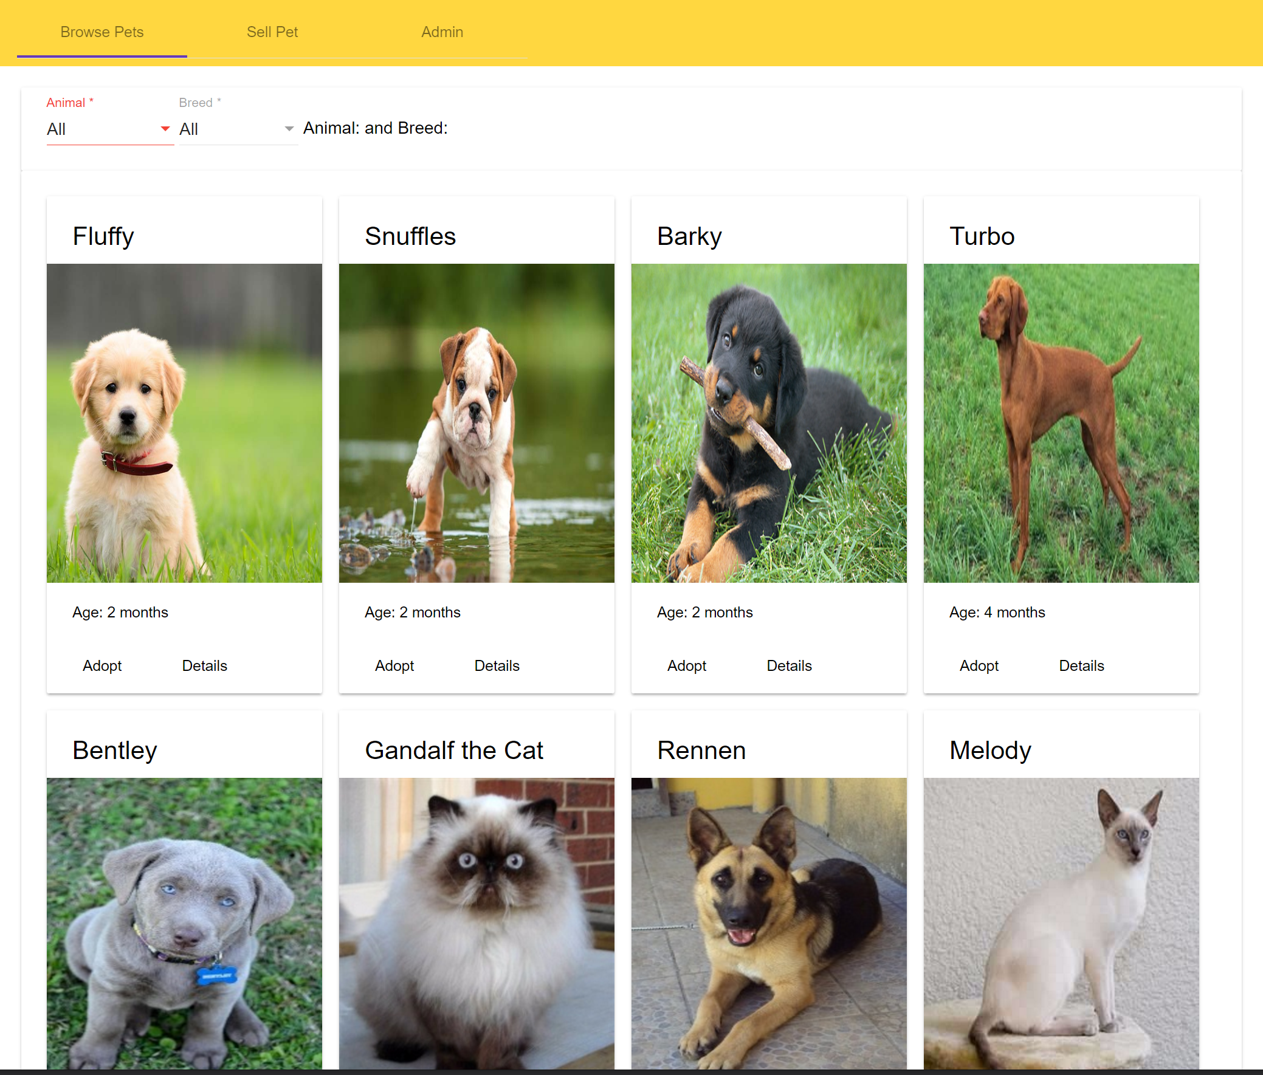
Angular 2 Overview
app.component
Browse-pets.component
pet.options
Open source, front-end framework for developing Single Page Application (SPA’s)
Supports TypeScript, Dart, or JavaScript
Component-based architecture
Up to 5x faster than AngularJS
pet-card.component
pet-card.component

Slide 8
Data Binding
Data binding is the mechanism for coordinating what users see with the component’s data values
One-Time Initialization
This is not data binding
<input type=“text” value=“Levi”>
{{person.name + ‘ is ’ + getAge(person.birthday)}}
<input [value]=“person.name”>
<input (input)=“name=$event.target.value”>
<input [(ngModel)]=“name”>
<input [ngModel]=“name” (ngModelChange)=“name=$event.target.value”>
<input [value]=“name” (input)=“name=$event.target.value”>
One-Way
Interpolation, Property, Attribute, Class, and Style Binding
Data source to view
Event Binding
One-Way from view to data source
Two-Way
Two-Way Binding
Property Binding + Event Binding

Slide 9
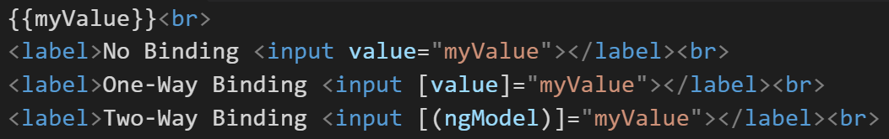
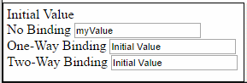
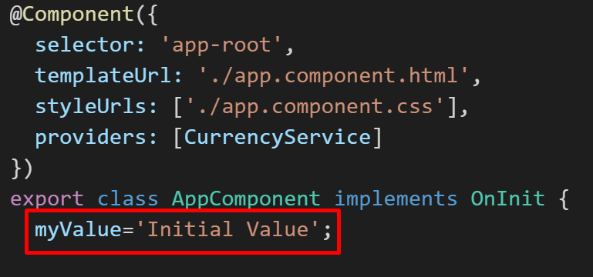
Template Binding Example
app.component

Slide 10
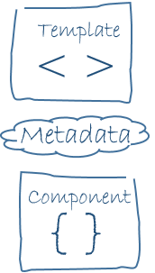
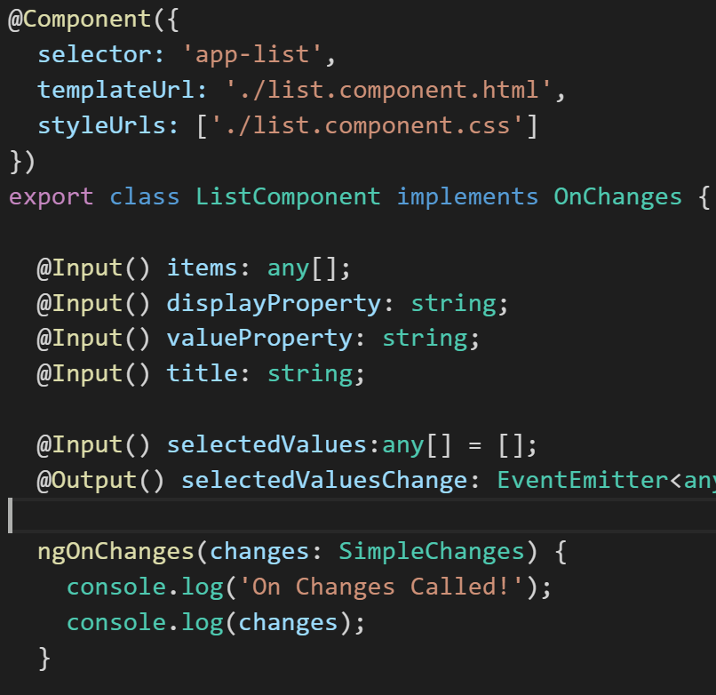
Decorators
Decorators are functions that provide a declarative way to add metadata to code
Metadata tells Angular how to process a class

Slide 11
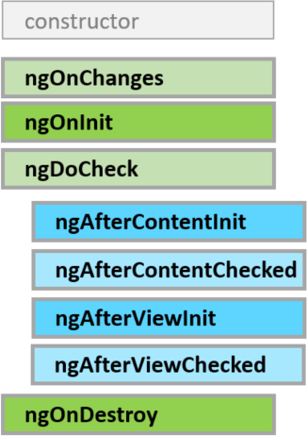
Lifecycle Hooks
Implemented by components and directives
Methods which are called when specific events occur
ngOnChanges() – called when data-bound input properties are set/reset
ngOnInit() – called shortly after the component is created
ngOnDestroy() – Called just before Angular destroys the directive component

Slide 12
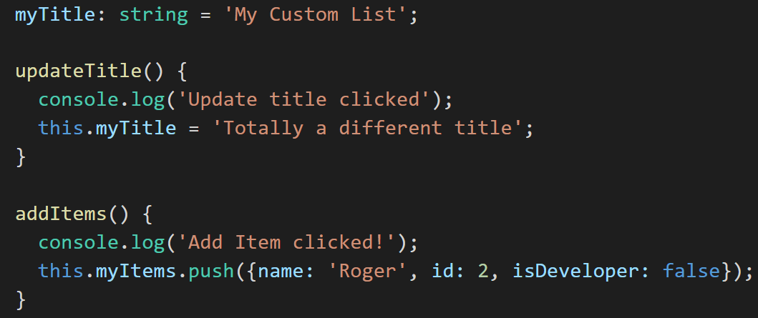
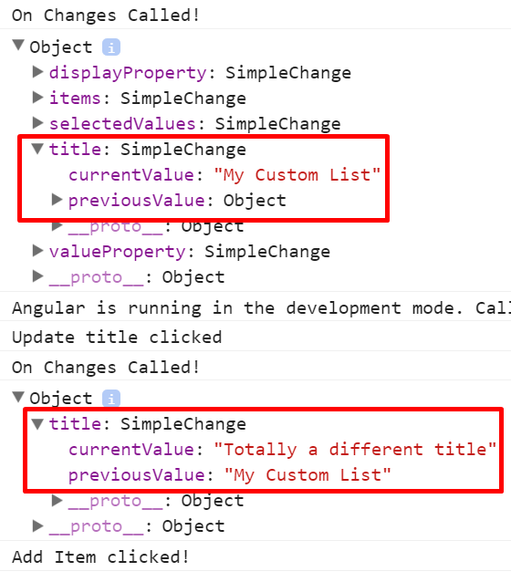
Lifecycle Hooks Example
list.component
app.component

Slide 13
@Directive()
Directive is an attribute which can extend/modify the functionality of an element
Target an element by its Selector – A CSS selector
‘[attributeToSelect]’
‘tag-to-select’
‘.class-to-select’
Three Types
Components - Directives with a template
Structural Directives – Change the DOM layout by adding/removing DOM elements
Attribute Directives – Change the appearance or behavior of an element

Slide 14
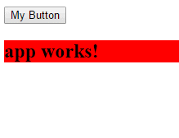
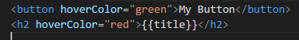
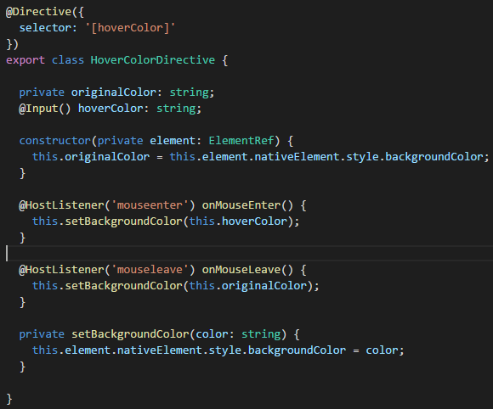
@Directive() Example
app.component
hover-color.directive

Slide 15
@Component()
A component is a directive with a template which contains logic for updating or retrieving data to/from the view
@Component({
selector: ‘app-list’,
templateUrl: ‘./list.component.html’,
styleUrls: [‘./list.component.css’],
providers: [ListService]
})
export class ListComponent {}
Element to componentize
Path to View
Path to Styles
Component-Scoped Services

Slide 16
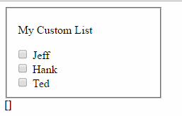
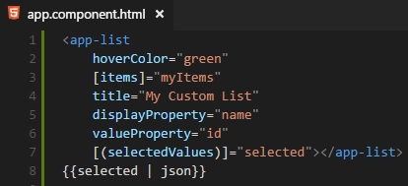
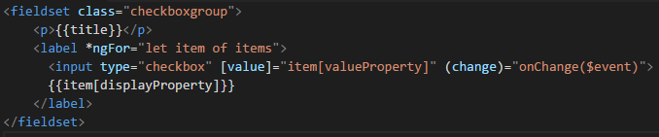
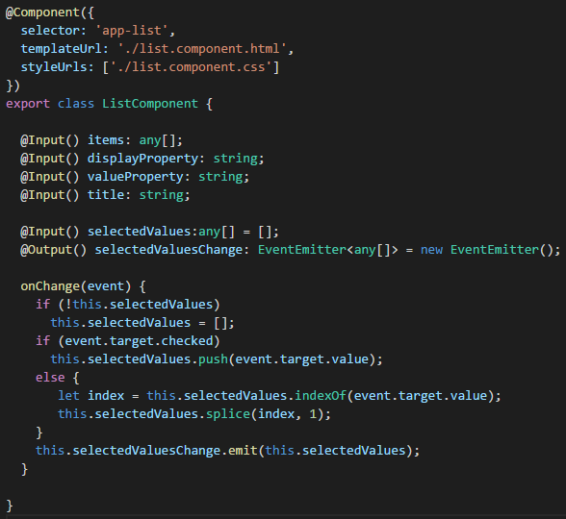
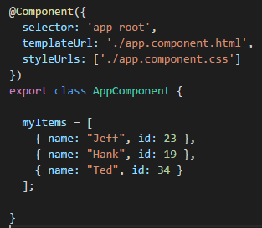
@Component() Example
app.component
list.component

Slide 17
@Pipe()
Pipes are used to transform data
Two Types
Pure – Only executed when a change is made to a primitive input value or a change to an object reference
Impure – Executed during every component change detection cycle
<p> {{ price | convertMoney : ’EUR’ : ’USD’ }} </p>
Object to
Transform
Pipe Name
Argument 1
Argument 2

Slide 18
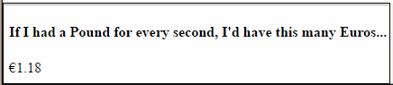
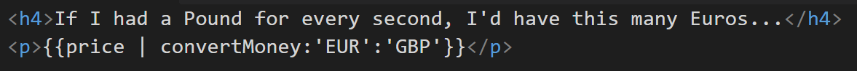
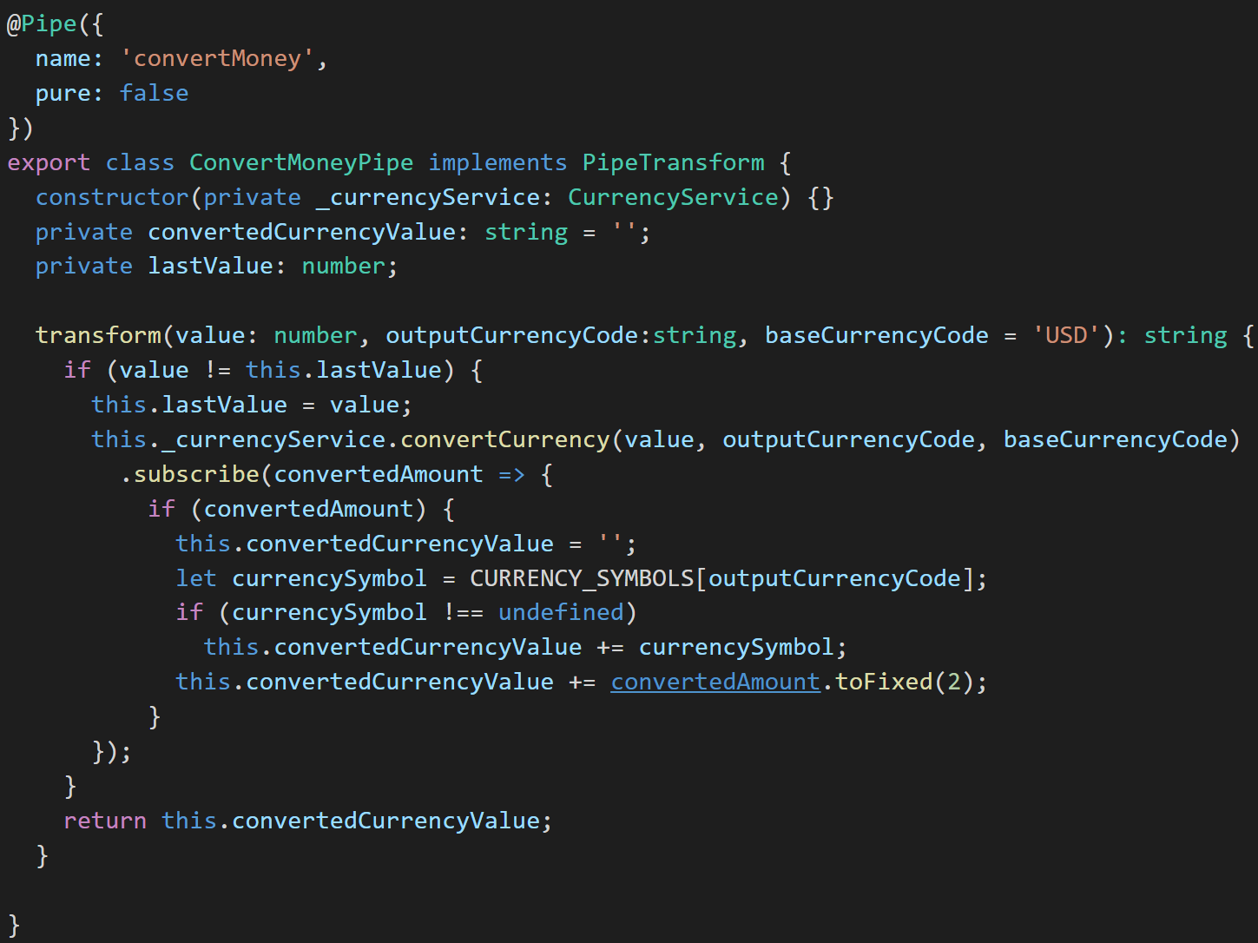
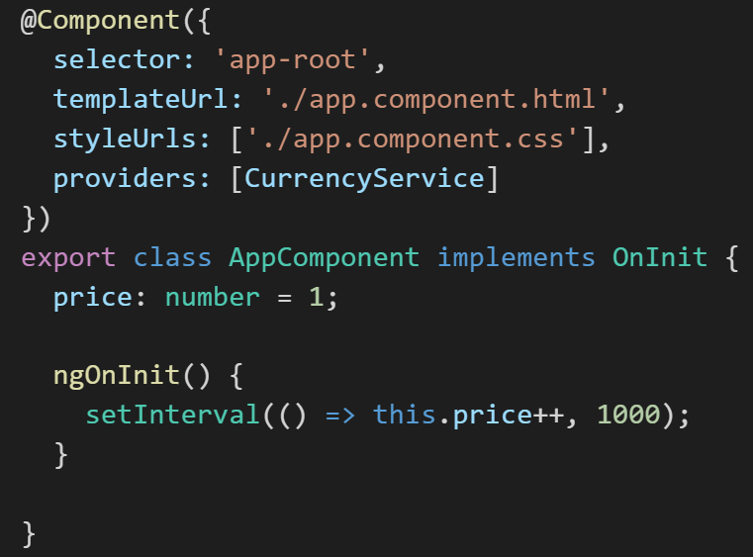
@Pipe() Example
app.component
convert-money.pipe

Slide 19
@Injectable()
Services are reusable classes which perform a specific task and are injected using Angular 2’s hierarchical Dependency Injection system
Constructor Injection
Decorated with @Injectable() if any dependencies are required
Singletons
Domain scoped to Root Module or instance of Component
Root Module
Root DI Container
Component A
Component B
Instance Scoped DI Container
Instance Scoped DI Container

Slide 20
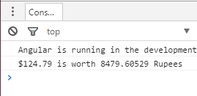
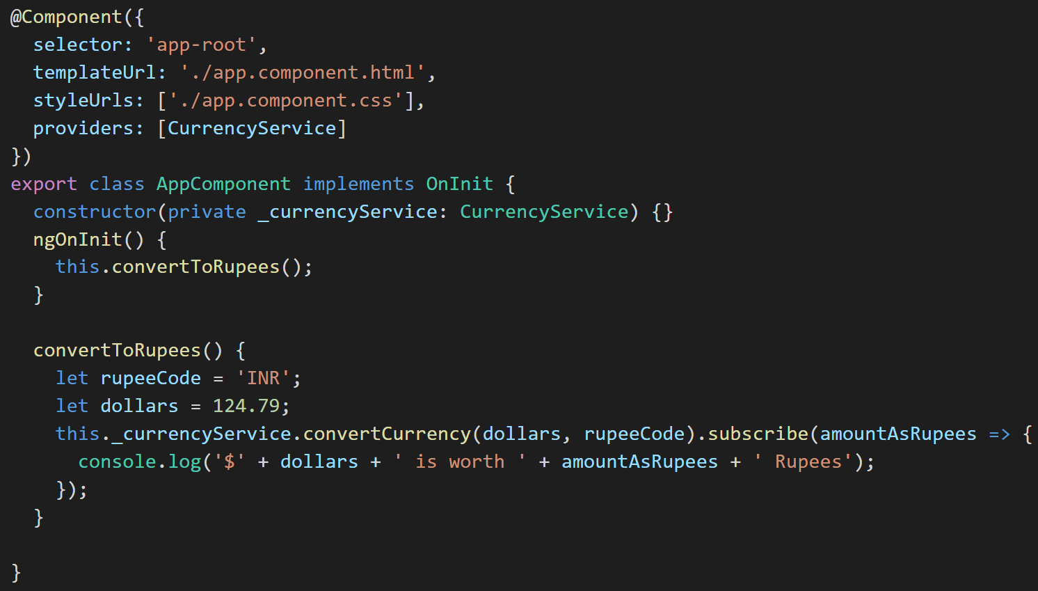
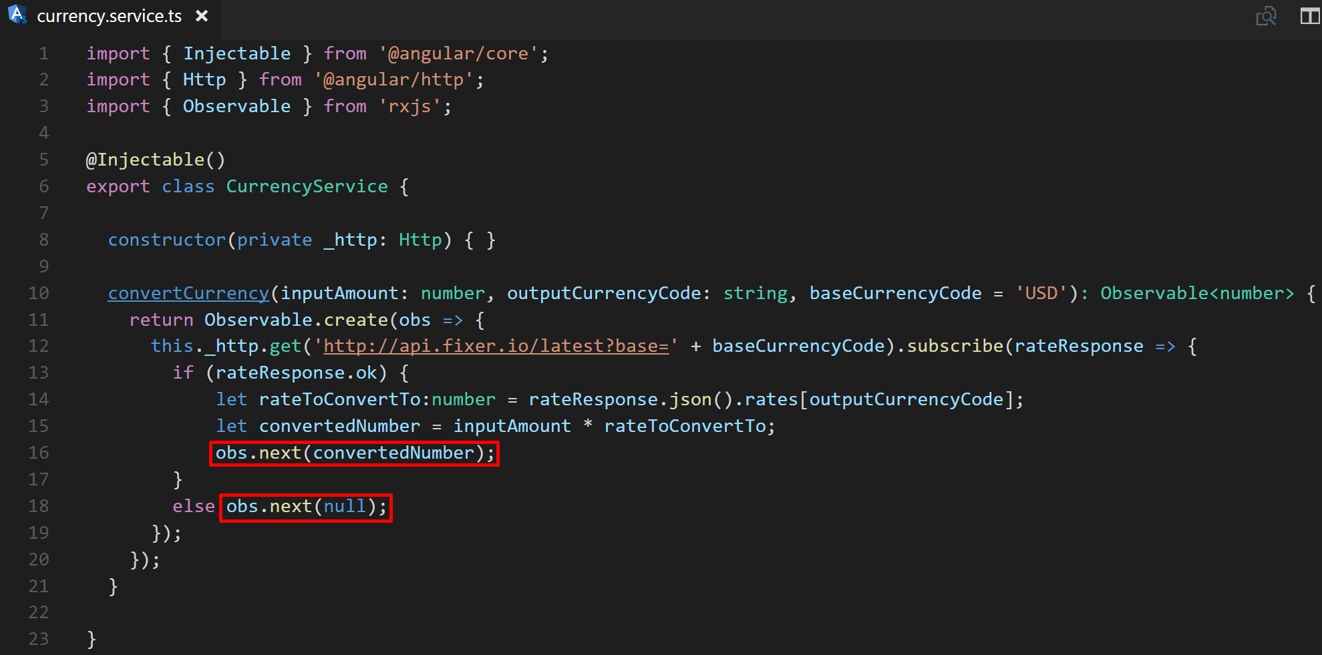
@Injectable() Example
app.component
currency.service

Slide 21
@NgModule()
Helps organize application or library into cohesive blocks of functionality
Declare what components, directives, and pipes (CDP’s) are used
Provide services at the root module level
@NgModule({
imports: [FormsModule, CommonModule],
declarations: [ListComponent, HoverColorDirective],
exports: [ListComponent],
providers: [ListService]
})
export class CustomControlsModule {}
Modules used by any declared CDP’s, standalone
Declare any CDP’s used by this module
All modules which will exported and made available to the importing module
Any services used by the declared modules; Will be added to the root DI container

Slide 22
ASP.NET Core

Slide 23
ASP.NET Core Overview
Built upon .NET Core, ASP.NET Core is a lean, cross-platform, open-source framework for building web and cloud applications
Supports C# and F#
All Features/Libraries via NuGet packages (similar to NPM)
Auto-Compiled Code
Native Dependency Injection
.NET Core and ASP.NET Core on Github

Slide 24
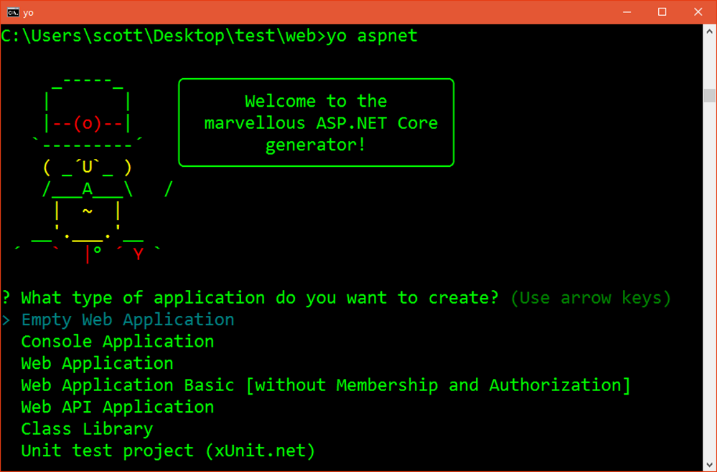
Dotnet Core Commands
dotnet new
creates a new project in the current directory
dotnet restore
installs the required NuGet packages
dotnet run
starts the application
yo aspnet
Options for scaffolding .NET Core apps

Slide 25
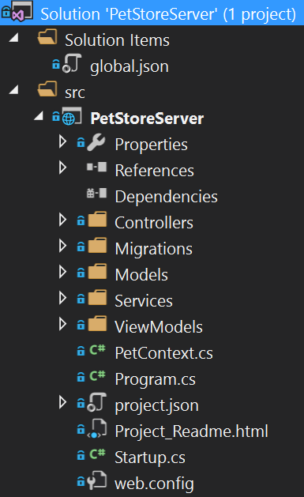
Components of ASP.NET Core
PetStoreServer.csproj
Specify dependencies, configurations, frameworks used and their versions
Program.cs
Application’s entry point
Host is created and ran from here
Startup.cs
The configuration file for ASP.Net Core
Inject services
Configure services

Slide 26
Dependency Injection
Adds services to a container in order to achieve loose coupling between objects and their dependencies
Constructor Injection
Service Types
Transient
Scoped
Singleton
Startup.cs
Public void ConfigureServices(IServiceCollection services) {
services.AddCors();
services.AddMvcCore().AddJsonFormatters();
services.AddScoped<PetService>();
services.AddSingleton<UtilityService>();
}
Public void Configure(IApplicationBuilder app, …) {
app.UseCors(cors => cors.WithOrigins(http://localhost:4200)
.AllowAnyHeader().AllowAnyMethod());
app.UseMvc();
}
Register Services
Use Services

Slide 27
Controllers
Classes that handle browser requests and retrieves model data
Route Template
http://myapp/api/pets
[Route(“api/[controller]”)
public class PetsController : Controller {
private readonly PetService _petService;
public PetsController(PetService petService) {
_petService = petService;
}
[HttpGet(“{animalId}”)]
public List<Pet> Get(long animalId, bool isForSale = false) {
return _petService.GetPets(animalId: animalId, isForSale);
}
}
Inherit Controller base class
Constructor Injection
HTTP Verb
http://myapp/api/pets/4?isForSale=true
Query String Parameters

